Slide 1
Data Analysis of Placement Dataset
Name: Arunabha Mondal
UID: 18BCS6074

Slide 2
About the Dataset
The dataset consists of the information regarding the 2020 pass out students who got placed.
The dataset consists of their marks in AMCAT (various fields such as quantitative, logical ability English verbal and many more).
Also the dataset has info regarding their projects, internships etc.
The main task was to find the factors that affect the dataset and get the info on the variation of salary based on those features.
The variation and the count based on each feature is shown through the graph.

Slide 3
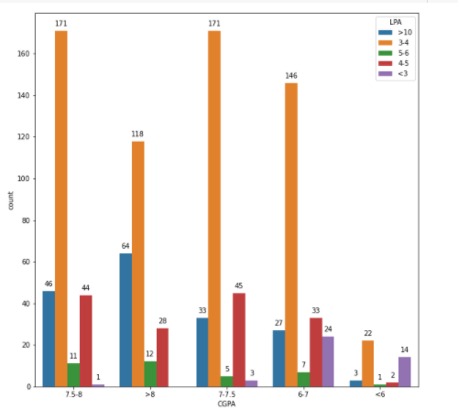
CGPA vs LPA
The graph shows the relation of CGPA to package LPA.
As the graph depicts that most of the placements was in range of 7-8 CGPA
The CGPA > 7.5 had higher chances of getting high packages such as > 6 LPA

Slide 4
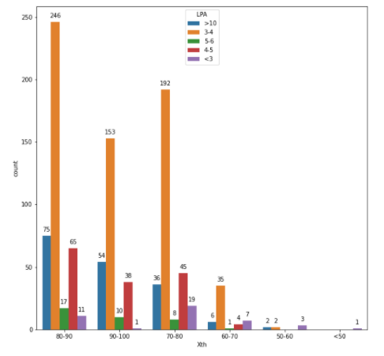
10th score vs LPA
The graph depicts the 10th score towards package.
The range of students with 10th score>70 have higher chance of getting placed.
The range of students with 10th score > 80 have higher chances of higher packages.

Slide 5
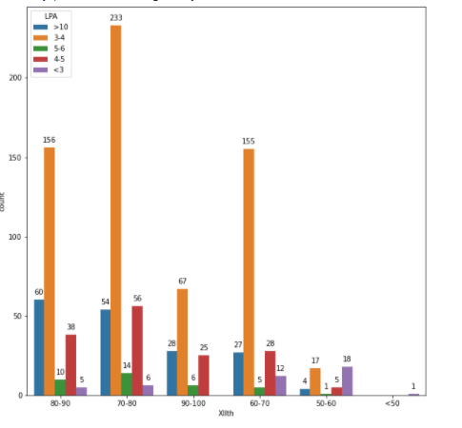
12th score vs LPA
The graph depicts the 12th score towards package.
The range of students with 12th score>60 have higher chance of getting placed.
The range of students with 12th score > 70 have higher chances of higher packages.

Slide 6
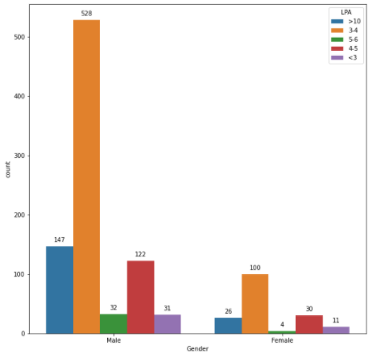
Gender vs LPA
The graph depicts the influence of gender on placement packages
As the population of male is higher more males are getting placed .

Slide 7
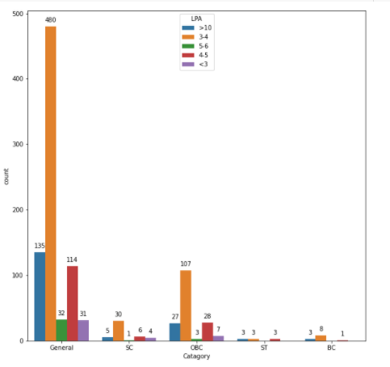
Category vs LPA
The graph depicts the influence of category on placement packages
General category is mostly placed.

Slide 8
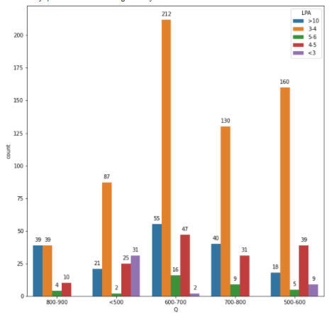
Quantitative vs LPA
The graph depicts the weightage of quantitative score.
The average range for getting good packages is 600-700

Slide 9
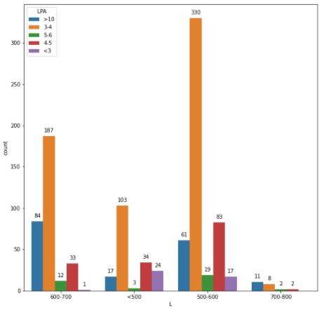
Logical Reasoning vs LPA
The graph depicts the weightage of logical reasoning score.
The average range for getting good packages is 500-700

Slide 10
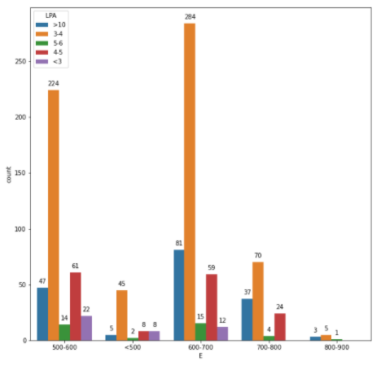
Verbal ability vs LPA
The graph depicts the weightage of verbal ability score.
The average range for getting good packages is 500-700

Slide 11
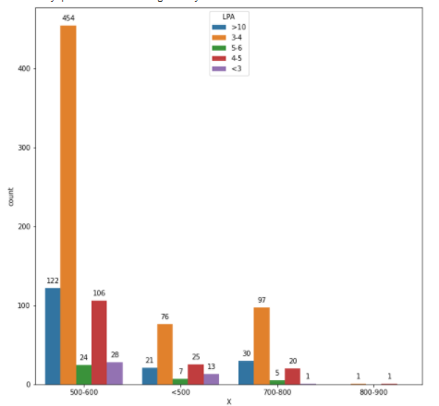
Write X vs LPA
The graph depicts the weightage of writing skills score.
The average range for getting good packages is 500-700

Slide 12
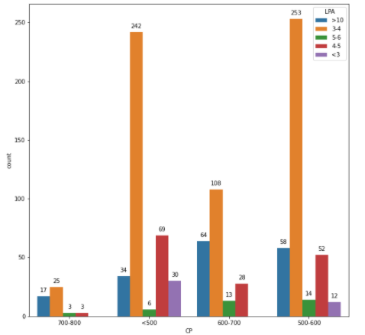
Computer programming vs LPA
The graph depicts the weightage of computer programming score.
The average range for getting good packages is 500-700.

Slide 13
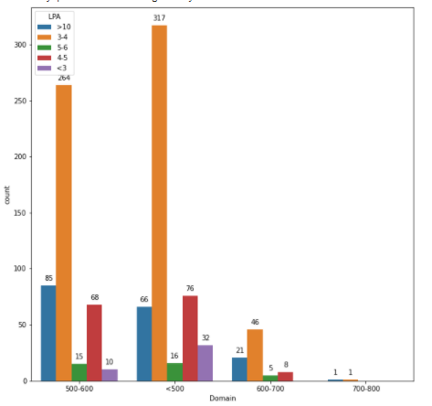
Domain vs LPA
The graph depicts the weightage of Domain score.
The average range for getting good packages is 400-600.

Slide 14
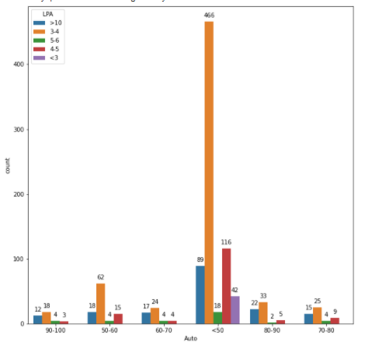
Automata vs LPA
The graph depicts the Automata score.
The automata score > 40 can get you good packages.

Slide 15
Conclusion
The aforementioned graphs show the various dependencies and various features on how the packages are defined and gives a brief idea on where the improvements needs to be done for the upcoming batches who can achieve better and higher packages and also the minimum required skills for the getting placed.

